Slide 1
Imaging the Magnetosphere
Review of Discoveries and Some Suggestions for Future Progress
J. Goldstein^{1, 2}
1 SwRI, 2 UTSA

Slide 2
Outline of Talk
Plasmaspheric Imaging (IMAGE Mission) (10)
2 Ring Current Imaging (TWINS Mission) ( 5)
3 Saturn’s Plasmasphere (Cassini Mission) ( 4)
4 Systems-Level Imaging (Future mission concepts) ( 2)
(21)

Slide 3
1. Plasmaspheric Imaging (IMAGE Mission)
Progress Enabled by Plasmaspheric Imaging
The ability to observe the global, dynamic plasmasphere:
• Helped confirm the very basic theoretical “convection + corotation” paradigm,
• Revealed (or made obvious) global patterns of behavior,
• Confirmed the profound importance of M-I coupling to the inner magnetosphere,
• Helped refine our models to a credible level of accuracy.

Slide 4
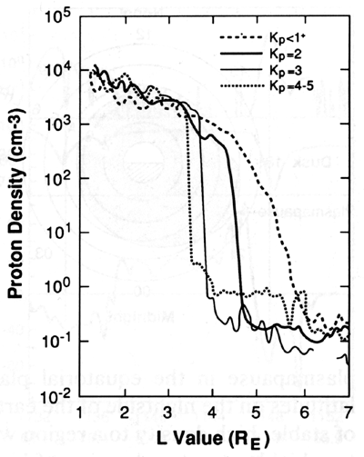
1. Plasmaspheric Imaging (IMAGE Mission)
Cycle of Plasmaspheric Erosion and Recovery
Chappell et al. [1970]
• OGO-5 in situ data.
• Plasmapause radial location varies inversely with geomagnetic activity.
• Plasmapause density profile can be highly structured.
25 June - 2 July 2000
[Goldstein et al., 2007]
• IMAGE EUV
• 2D plasmapause versus IMF Bz
• Predictable pattern of plasmaspheric morphology.
(a) Quiet (b) Duskside Plume (c) Plume Rotates (d) Plume Wraps (e) Refilled
Pre-Erosion Main Erosion Erosion Slows Recovery Recovered
Filling dominant Erosion dominant Filling dominant

Slide 5
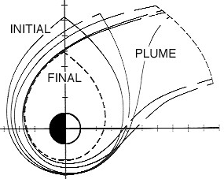
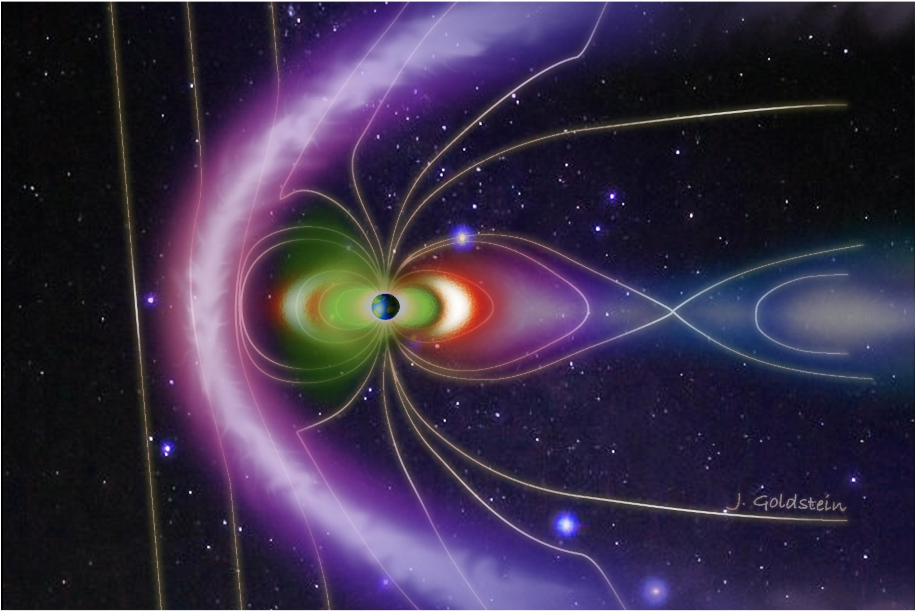
1. Plasmaspheric Imaging (IMAGE Mission)
Phases of the Plasmasphere: Plumes
Grebowsky [1970], Chen & Wolf [1972], Weiss et al. [1997], Lambour et al. [1997].
• Test particle simulation subject to corotation and convection.
• Plumes form in response to enhanced convection.
Enhanced Convection: Plume Forms
Reduced Conv.: Plume Rotates, Wraps

Slide 6
1. Plasmaspheric Imaging (IMAGE Mission)
Phases of the Plasmasphere: Plumes
Goldstein and Sandel [2005]
• Plasmasphere images show the theoretically-predicted global pattern of plume formation and evolution.
Goldstein et al. [2004]
• With initial conditions specified from plasmasphere images, the simple model can do a credible job of predicting the global plasmaspheric morphology.
18 June 2001
26 - 27 June 2000
(a) Quiet (b) Plume Forms (c) Plume Narrows (d) Plume Rotates / Wraps
Pre-Erosion Erosion Onset Erosion Slows Recovery Begins
(a) Quiet (b) Plume Narrows (c) Plume Narrows (d) Plume Rotates / Wraps

Slide 7
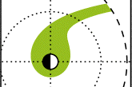
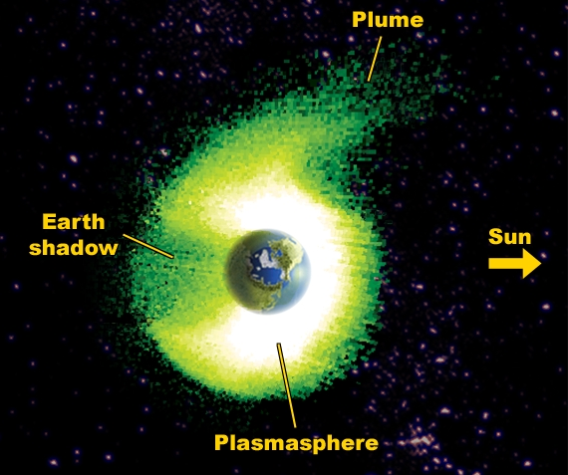
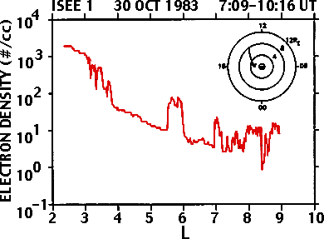
1. Plasmaspheric Imaging (IMAGE Mission)
Global Context
Theory:
Grebowsky Plume
The global context (from imaging and image-validated models) has provided a framework (plasmaspheric plume phases) to interpret decades of in situ data.
Goldstein et al. [2005d]
Observation:
“Detached Plasma”
Carpenter et al. [1993]

Slide 8
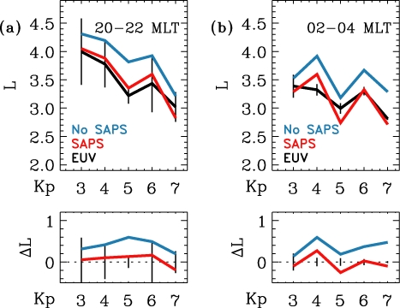
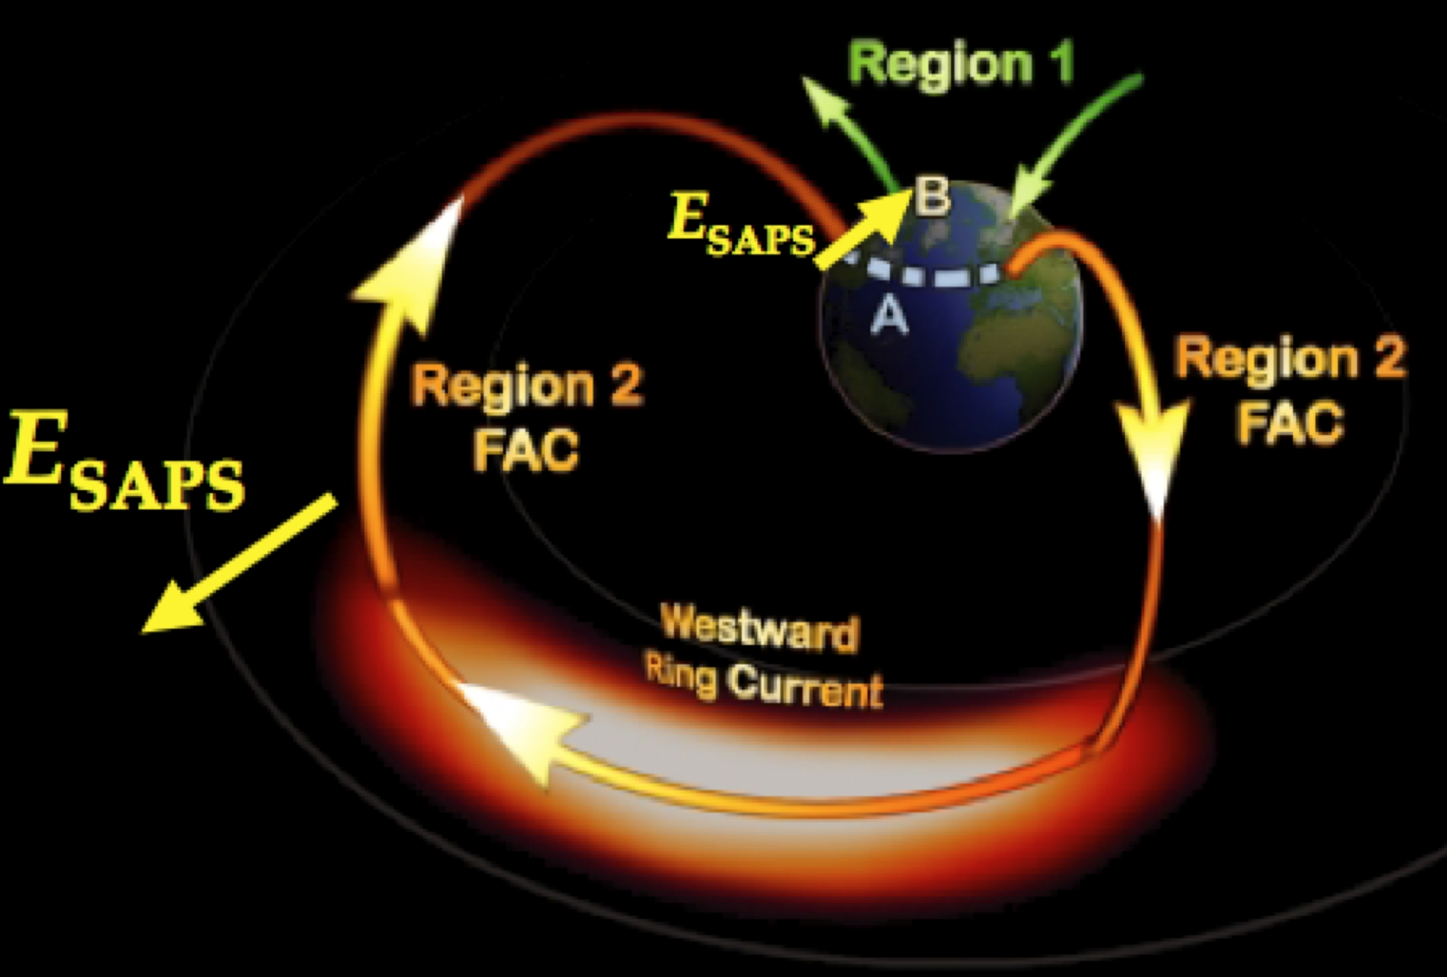
1. Plasmaspheric Imaging (IMAGE Mission)
Improving Models by Including M-I Coupling: SAPS
Goldstein et al. [2003c; 2005e]
• Ring current-ionosphere (RC-I) coupling plays a crucial role in the inner magnetosphere.
SAPS (Sub-Auroral Polarization Stream)
Convection Enhancement by the Ring Current
A duskside flow channel that enhances SW-driven convection.
Goldstein [2006]

Slide 9
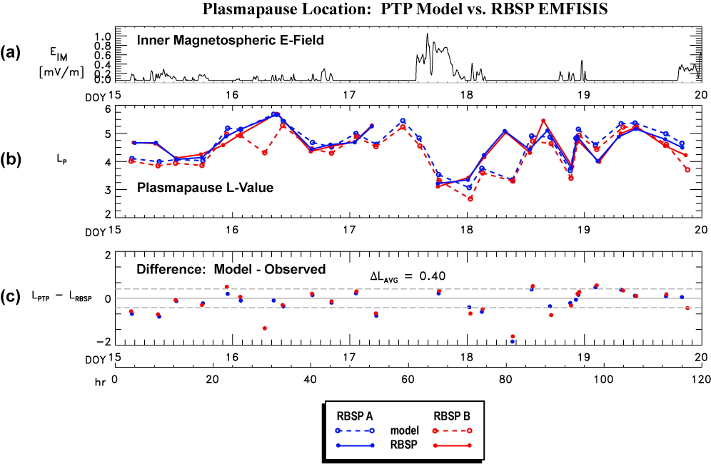
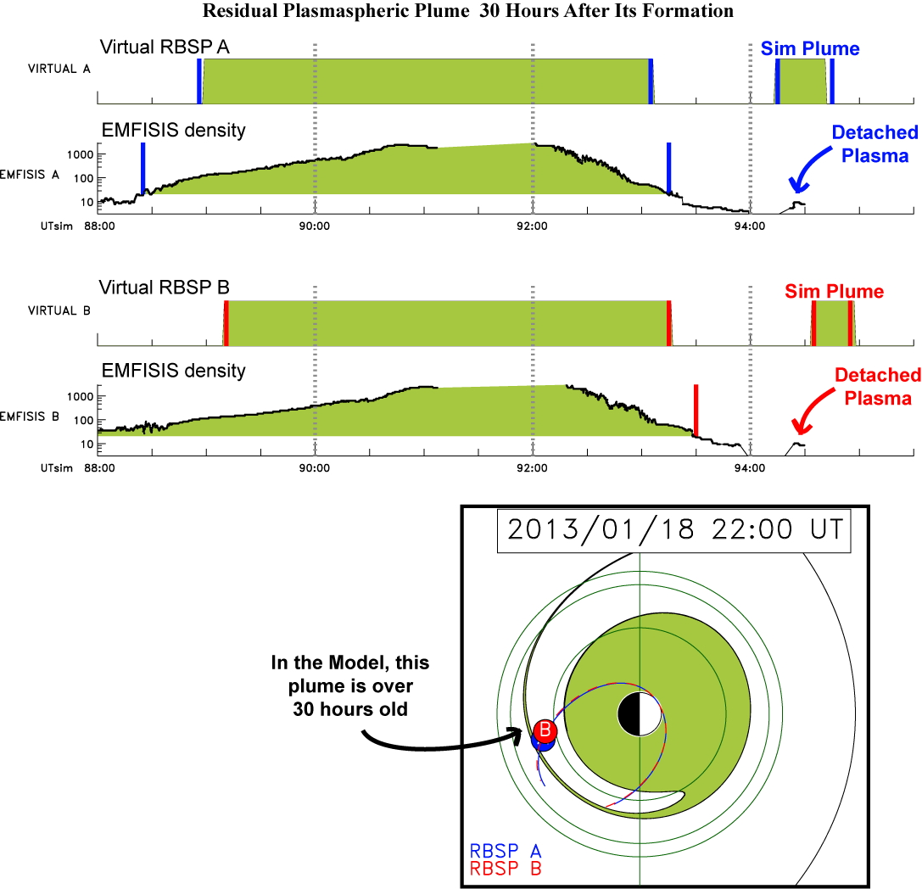
1. Plasmaspheric Imaging (IMAGE Mission)
Modern Performance of an IMAGE-Validated Model
• The model validated using IMAGE EUV plasmasphere images... is now providing global context for the Van Allen Probes (RBSP) mission. [Goldstein et al., 2014]
Quantitative Comparison: Model Compared to EMFISIS Data
Simulation 15 – 19 Jan 2013
• EMFISIS: in situ wave-derived density.
• Virtual RBSP A and B flythroughs.
Noteworthy:
• EMFISIS sees very low density detached plasma region roughly where the model predicts there is a 32-hour-old residual plume.
Model Plasmapause: Agrees with EMFISIS within 0.4 R_{E} on average.

Slide 10
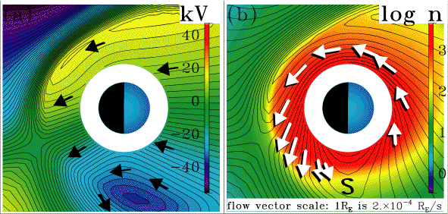
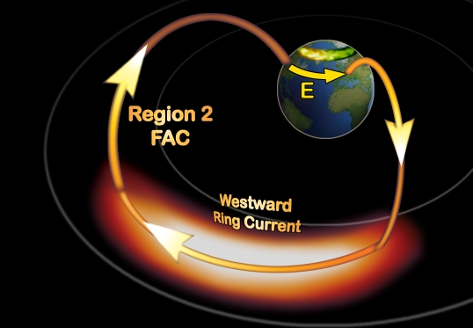
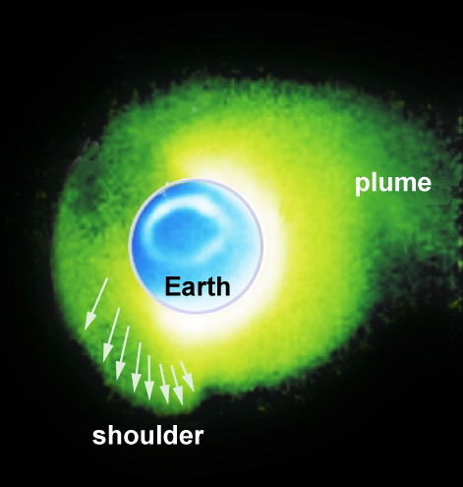
1. Plasmaspheric Imaging (IMAGE Mission)
Validating Models That Include M-I Coupling: Shielding
Jaggi and Wolf [1973], Goldstein et al. [2002]
• Ring current-ionosphere (RC-I) coupling plays a crucial role in the inner magnetosphere.
Shielding
“Reverse 2-cell convection”: opposing SW-driven flow.
Shielding
“Reverse 2-cell convection”: opposing SW-driven flow.
Overshielding
Shielding too strong: reverse convection field pulls plasma outward, creating shoulders.
Magnetospheric Specification Model (MSM)
• Empirical form of RCM
• RC-I coupling driven by Kp, SW / IMF, ABI
Goldstein [2006]
24 May 2000 7:04 UT
Plasmaspheric Shoulders
Discovered and Explained
B
E_{shielding}
V_{shielding}

Slide 11
1. Plasmaspheric Imaging (IMAGE Mission)
Work on IMAGE EUV Continues
Nakano et al. [2014a, 2014b]
New analysis techniques for obtaining global equatorial He+ density... and equatorial E-fields.
He+ Density from EUV
• Bayesian inversion technique
• Validated using model distribution
• Considers Poisson noise but not sunlight
IMAGE EUV 8:32 UT 20 June 2001
ExB Drift and Electric Fields from EUV
• Track motion of boundary
Synthetic EUV
ExB Drift and Electric Fields from EUV
• Kalman filtering technique
• Validated using model E-field & densities
• Extract flows (E-field) inside boundary
E-Field @ L=3.5
Extracted
True
Goldstein et al. [2004, 2005e]

Slide 12
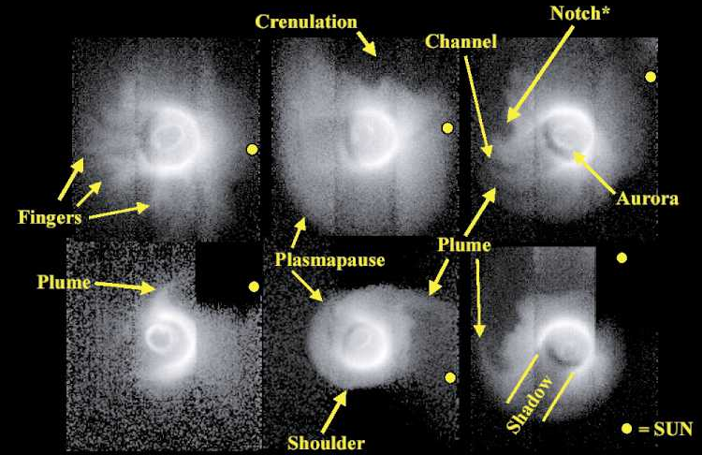
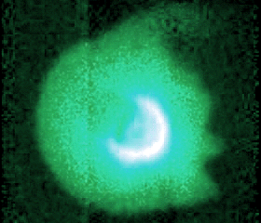
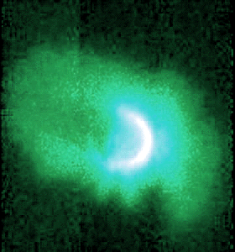
1. Plasmaspheric Imaging (IMAGE Mission)
The Future of EUV Plasmasphere Imaging (at Earth)
“Zoo” Of Recovery Phase Structure
What’s Left to Study?
• Quiet Time Plasmasphere: Still a Mystery!
• Plasmasphere as part of an integrated system of coupled, self-modifying plasmas
What’s Left to Study?
• Quiet Time Plasmasphere: Still a Mystery!
• Plasmasphere as part of an integrated system of coupled, self-modifying plasmas
Wish List:
• Higher time resolution: Erosion Timing
• Better sensitivity: Plume Influence on Dayside Reconnection... (large L dayside)
Gallagher et al. [2004]

Slide 13
2. Ring Current Imaging (TWINS Mission)
Progress Enabled by Ring Current Imaging
A few examples

Slide 14
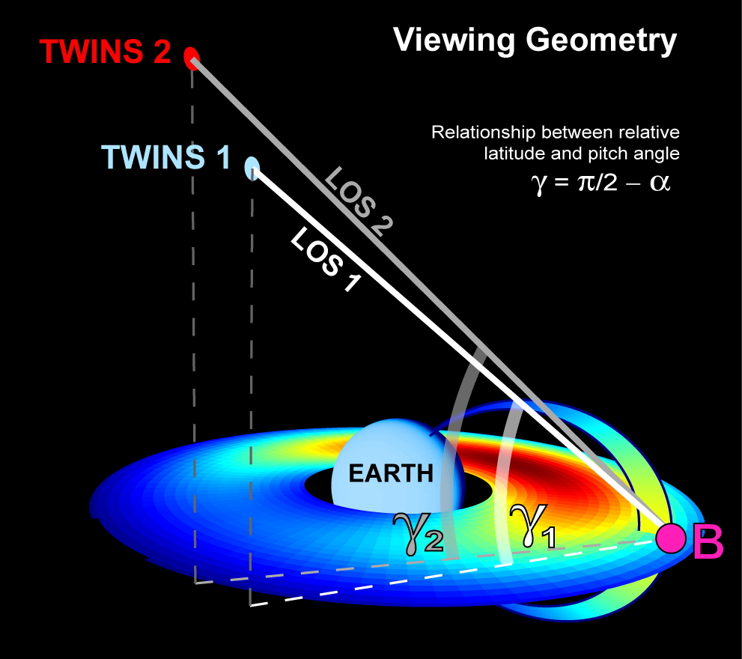
2. Ring Current Imaging (TWINS Mission)
Local-Time Dependent Pitch Angle Anisotropy
Goldstein et al. [2012a, 2012b], Goldstein and McComas [2013]
Stereo energetic neutral atom (ENA) imaging reveals global dawn-dusk asymmetry in ion PA.
• Viewing Geometry:
Similar MLT,
Different LAT
• Duskside ENAs:
TWINS 2 (higher LAT)
half as bright as
TWINS 1 (lower LAT)
• MLT and Energy Dep: Duskside PA anisotropy much higher—for lower energies.
• Viewing Geometry:
Similar MLT,
Different LAT
• Duskside ENAs:
TWINS 2 (higher LAT)
half as bright as
TWINS 1 (lower LAT)

Slide 15
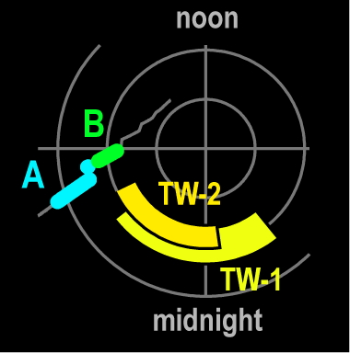
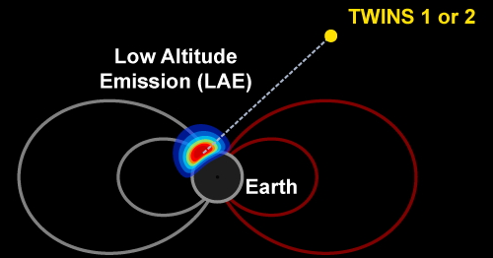
2. Ring Current Imaging (TWINS Mission)
Local-Time Dependence of Precipitating Ion Spectra
Goldstein et al. [2013], Goldstein and McComas [2013]
Stereo ENA imaging analysis of Low Altitude Emissions (LAEs) yields new ion precipitation data.
• Thick Target Analysis:
[Bazell et al., 2010]
Multiple charge exchange & stripping interactions
• Low Altitude Emission:
LAEs are the ENA signature of ion precipitation
• Validation of TTA Analysis:
Simultaneous NOAA data agrees with TWINS ions
• MLT Dependence:
More peaked spectra (higher avg. energy) near dusk

Slide 16
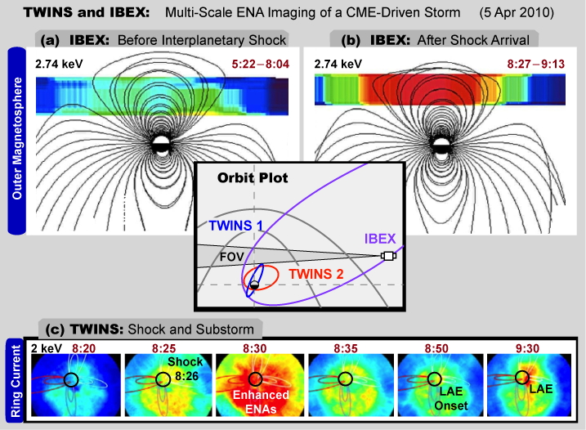
2. Ring Current Imaging (TWINS and IBEX)
Multi-scale Magnetospheric Imaging
McComas et al. [2012], Goldstein and McComas [2013]
TWINS and IBEX ENA imaging obtain a truly global view of the arrival of an interplanetary shock.
• CME-Driven Storm:
Shock arrival at 8:26 on 5 Apr 2010
• Globally enhanced ENAs in response to shock
• Enhanced LAEs (ion precipitation) ~20 min later

Slide 17
2. Ring Current Imaging (IMAGE Mission)
Postmidnight Ring Current Peak: RC-I Coupling
Brandt et al. [2002], Fok et al. [2003], Burch [2005]
Ring current imaging showed the peak of the ring current “skewed” eastward, contradicting “classic” RC theory but in agreement with models that include strong coupling via Region 2 currents.
OBSERVATIONS MODELS
• RC peak (27-39 keV) in postmidnight MLT sector.
• CRCM, with self-consistent Region 2 coupling, reproduces eastward-skewed peak.
• Weimer (empirical model) does not.
IMAGE HENA 27-39 keV
12 Aug 2000, 11:00 UT
CRM Simulation 32 keV
12 Aug 2000, 11:00 UT
Weimer Model 32 keV
12 Aug 2000, 11:00 UT
0.0 1.8E6 3.5E6
Future of Magnetospheric ENA Imaging
• Higher spatial resolution for inner magnetosphere: Study meso-scale structure, interchange, etc.
• Higher time resolution for outer magnetosphere: Study dynamics of dayside boundary region

Slide 18
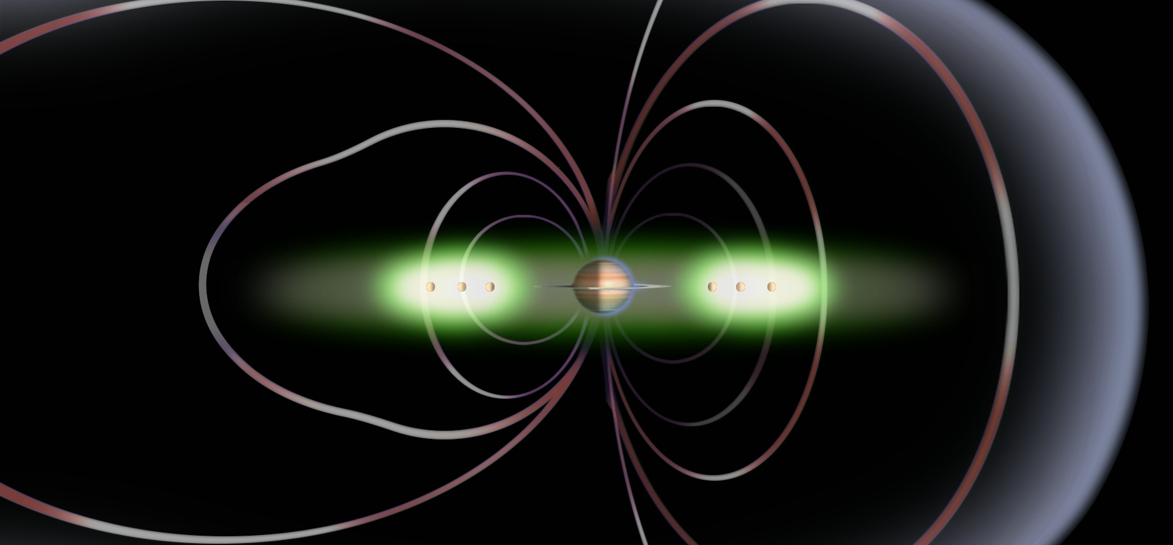
3. Saturn’s Plasmasphere (Cassini Mission)
Ring-Current Generated Global Structure at Saturn
Application of the shielding paradigm to the Saturnian system.

Slide 19
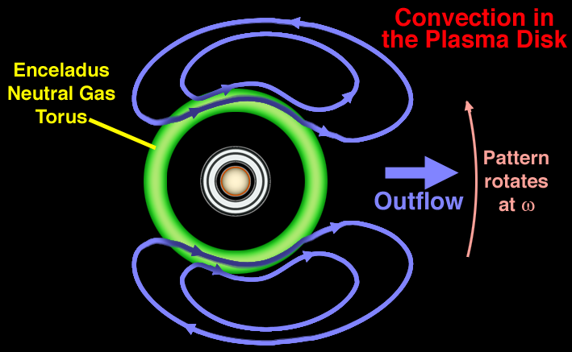
3. Saturn’s Plasmasphere (Cassini Mission)
Saturn’s “Plasma Cam”
Gurnett et al. [2007], Burch et al. [2009], Goldstein et al. [2014]
Global, cam-shaped density distribution of Saturn’s plasmasphere
• Global m=1 Density Mode
14 Cassini orbits show sinusoidal (m=1) density, rotating with the planet with peak at 330º SLS3 longitude
• “Cam-Shaped” Density
3+ years of CAPS data:
Lobe out to 25 R_{S} @330º SLS3.
Perturb. δL ~4% at L=6.
• Interchange Theory:
High-m modes dominate
[Hill, 2006; Yang et al., 1994; Goldstein et al., 2001, 2002]
• Selected by Nature?
Several authors have proposed global, rotating two-cell (m=1) convection
[Gurnett et al., 2007; Hill et al., 1981; Goldreich and Farmer, 2007]

Slide 20
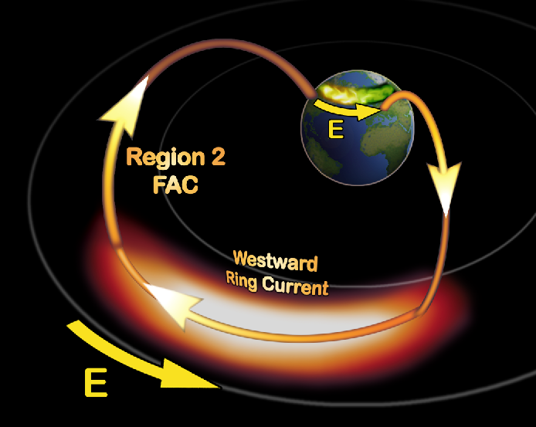
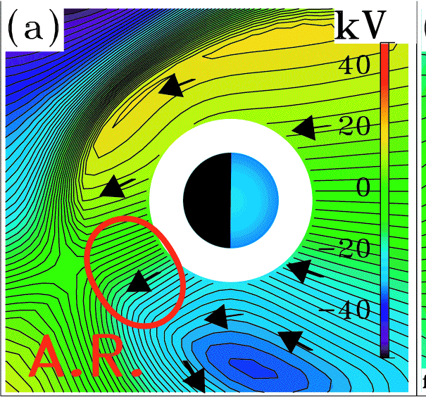
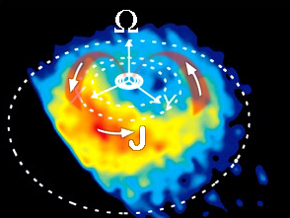
3. Saturn’s Plasmasphere (Cassini Mission)
Initiated by the Ring Current?
Goldstein et al. [2014]
Can a RC-generated 2-cell potential (“shielding”) act as a “seed potential” to initiate the m=1 mode?
At Earth:
At Saturn:
• Inner Magnetospheric Shielding
[Jaggi and Wolf, 1973]
RC-ionosphere coupling
• Corotating Ring Current
[Mitchell et al., 05; Krimigis et al., 07]
RC corotates with SLS3 for many hours
• Inner Magnetospheric Shielding
[Goldstein et al., 2002, 2003, 2006]
Antisunwd 2-Cell => Plasmaspheric Shoulder
MODEL:
antisunward 2-cell
11:01 13:09 15:17
SUN
17:25 19:33 21:41
OBSERVATIONS:
plasmaspheric shoulder
15:17

Slide 21
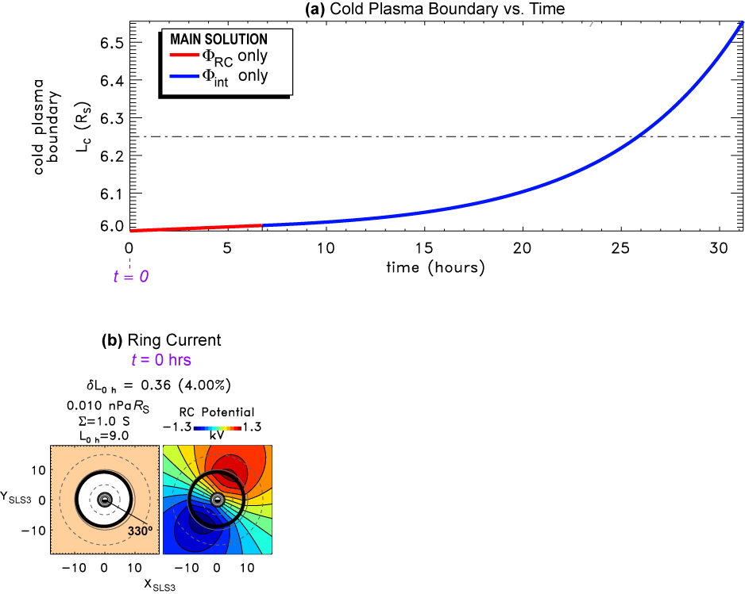
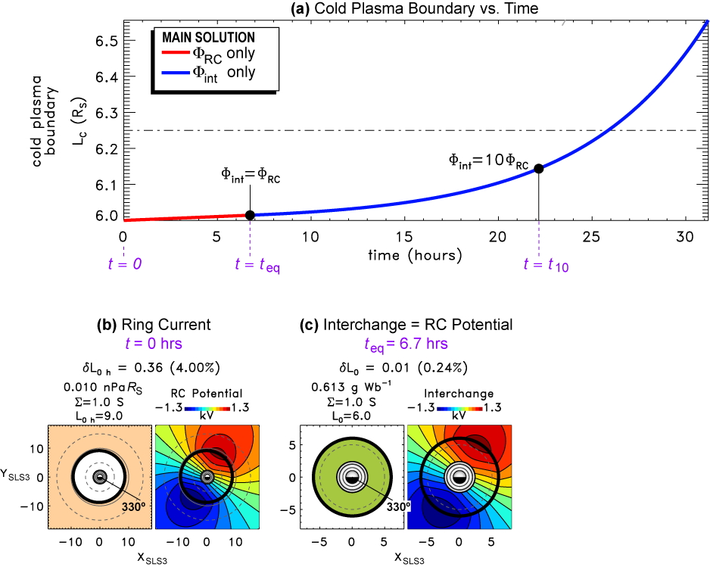
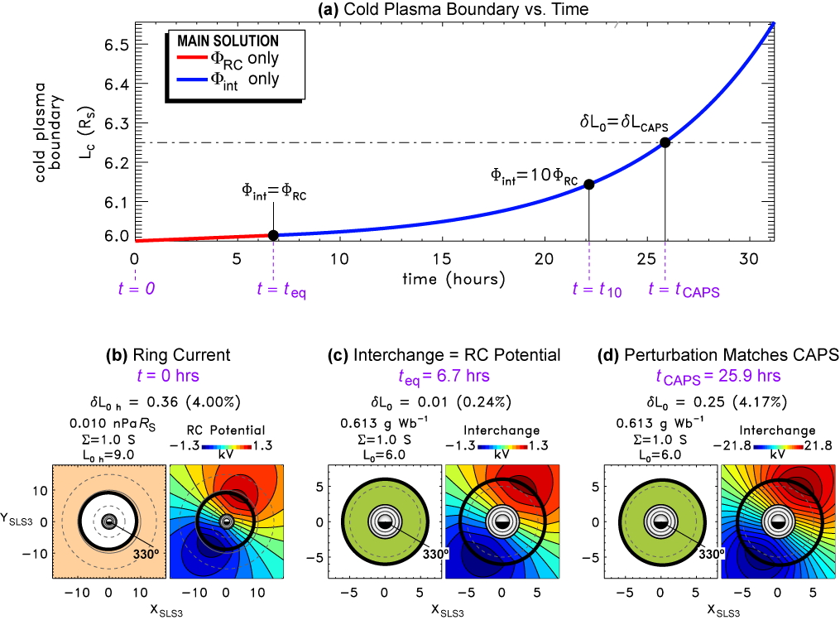
3. Saturn’s Plasmasphere (Cassini Mission)
Initiation of m=1 Interchange
Goldstein et al. [2014], based heavily on Hill [2006]
A ring-current generated “seed potential” can reproduce the observed density cam within ~26 hours.
t=0:
Φ_{RC} only.
t = 6.7 hrs:
Φ_{int} = Φ_{RC}
t = 22 hrs:
Φ_{int} = 10 Φ_{RC}
t = 26 hrs:
δL = CAPS
4% at L=6

Slide 22
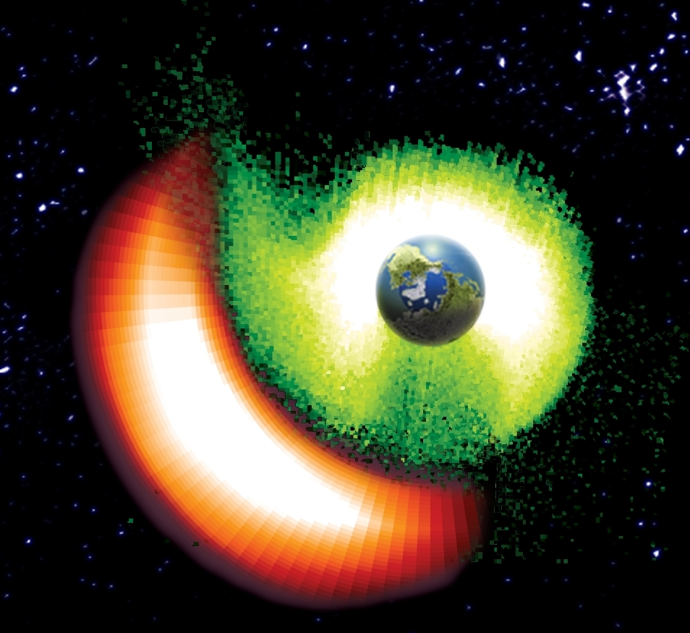
4. Systems-Level Imaging (Future Missions)
Saturnian Plasmaspheric Imaging
Future Mission Concept
At Saturn, our knowledge of global dynamical relationships between RC and plasmasphere is limited by the lack of plasmasphere imaging.
• Terrestrial M-I Coupling
ENA and EUV imaging, global dynamics
• Saturnian Imaging
ENAs but no EUV
• Saturn’s Plasmasphere
Global dynamics inferred from modeling and statistical analysis of in situ data.

Slide 23
4. Systems-Level Imaging (Future Missions)
Magnetospheric Activation and Geospace Ion Circulation
Future Mission Concept
Solar wind measurements plus simultaneous optical imaging of cardinal magnetospheric boundaries.
Apogee Outside Bow Shock
Apogee Outside Bow Shock
Apogee Outside Bow Shock
Apogee Outside Bow Shock
Apogee Outside Bow Shock
• In Situ Solar Wind
Direct SW input
• Dayside Boundary
Magnetosheath response: shape, size, location
In Situ Solar Wind
In Situ Solar Wind
In Situ Solar Wind
In Situ Solar Wind
In Situ Solar Wind
• Plasmasphere
Erosion, mass loading, convection, and feedback to dayside reconnection
FUV Imager
(Aurora)
FUV Imager
(Aurora)
• Aurora
Polar cap area, energy & magnetic flux transport
EUV Imager
(Plasmasphere)
EUV Imager
(Plasmasphere)
• SINGLE SYSTEM
Truly global magnetospheric imaging: Cause and Effect.
Soft X-Ray Imager
(Dayside Boundary)
Soft X-Ray Imager
(Dayside Boundary)

Slide 24
Imaging the Magnetosphere
Questions and Comments?
• Confirmed basic theories
• Discovered new global structures & behavior
• Demonstrated the system-level importance of M-I Coupling
• Refined our models
• Provided universal paradigms for comparative magnetospheric physics

